Slide 1
THE BANNING OF UNREGULATED DEPOSIT SCHEMES ORDINANCE , 2019
R.Krishnan ,
M.com , FCA , DISA

Slide 2
BACKGROUND
As per Law Minister Ravi Shankar Prasad , the CBI has lodged about 166 cases in the last 4 years related to chit funds and multi-crore scams, with the maximum in West Bengal and Odisha.
As per RBI, during the period between July 2014 and May 2018, 978 cases of unauthorised schemes were discussed in State Level Coordination Committee (SLCC) meetings.
In various states/UTs cases/ issues were forwarded to the respective regulators/law enforcement agencies in the states.
A large number of such instances have been reported from the eastern part of the country

Slide 3
THE BIRTH OF UDS ORDINANCE
Current laws of the country do not provide much regulatory protection to them, unlike the investors in the organized shares and securities market where SEBI provides adequate protections. India, which has a significant illiterate and unaware population, has many incidents where many people fall prey to such schemes.

Slide 4
THE BIRTH OF UDS ORDINANCE
The President of India , promulgated the BUDS Ordinance w.e.f 21st February 2019.
It extends to the whole of India except J&K.
Introduced to curb the menace of illicit deposit/ponzi schemes.

Slide 5
THE BIRTH OF UDS ORDINANCE
FM, in the Budget 2017-18, had announced that the draft bill to curtail the menace of illicit deposit schemes had been placed in the public domain and would be introduced shortly after it’s finalisation.
Lok Sabha passed the Bill to this effect on the last day of the budget session by a voice-vote, but the legislation could not get the approval of the Rajya Sabha.
So, the law was enforced in the form of Ordinance.

Slide 6
THE BIRTH OF UDS ORDINANCE
The Ordinance will help put a check on illicit deposit taking activities like Saradha scam and Rose Valley chit fund scam in the country.
Many such schemes dupe poor and the financially illiterate of their hard earned savings.

Slide 7
GOVERNMENT INITIATIVE
Jul 18,2018
The Banning of Unregulated Deposit Schemes Bill, 2018 was introduced in Lok Sabha by the Minister of State for Finance, Mr. Shiv Pratap Shukla
Aug 10,2018
Referred to Standing Committee
Jan 03 , 2019
Standing Committee Report was submitted
Feb 13, 2019
Passed in Lok Sabha
Feb 21,2019
The President promulgated the Ordinance.

Slide 8
OBJECTIVES
To provide for a comprehensive mechanism to ban the unregulated deposit schemes
To protect the interest of depositors
To tackle the menace of illicit Deposit taking activities that dupe gullible investors

Slide 9
OBJECTIVES
To prevent unregulated deposit schemes or arrangements at their inception
Makes soliciting, inviting or accepting deposits pursuant to an unregulated deposited scheme as a punishable offence.

Slide 10
Deposit ???
An amount of money received by way of an advance or loan or in any form by any deposit taker with a promise to return:
Whether after a specified period or otherwise
Either in cash or in kind or
In form of a specified service
With or without any benefit in the form of interest, bonus , profit or in any other form.

Slide 11
Deposits excluded from the ordinance
Bank/NBFC/Financial Institutions/Insurance companies
The Government or repayment guaranteed by them.
Statutory Authority constituted under an act of parliament or a state legislature
Foreign Govt., Foreign/international banks/Foreign export credit collaborators etc. Foreign citizen , Foreign authorities or person resident outside India subject to the FEMA 1999
Amounts received from;

Slide 12
Deposits excluded from the ordinance
Capital contribution by partners, Receipts from relatives by Individuals / Partners
By an asset reconstruction company registered with RBI.
By a Political Party u/s 29B of The Representation of People Act 1951
Amounts received from;
* Relative shall have the meaning as defined in section 2(77) of The Companies Act , 2013

Slide 13
Deposits excluded from the ordinance
In connection with Business including
Payment, advance or part payment for supply of goods/provision of services.
Advance received in connection with consideration of immovable property subject to the condition that such advance is against such immovable property
Security /dealership deposit for the performance of the contract.
Advance under long-term projects for supply of capital goods.

Slide 14
Deposits excluded from the ordinance
Provided that
If the above mentioned amounts in connection with business become refundable, these shall be deemed to be DEPOSITS on the expiry of 15 days from the date on which they become due for refund.
If the Deposit taker did not obtain necessary permission to deal in the goods / properties / services for which money is taken, these shall be deemed to be deposits.

Slide 15
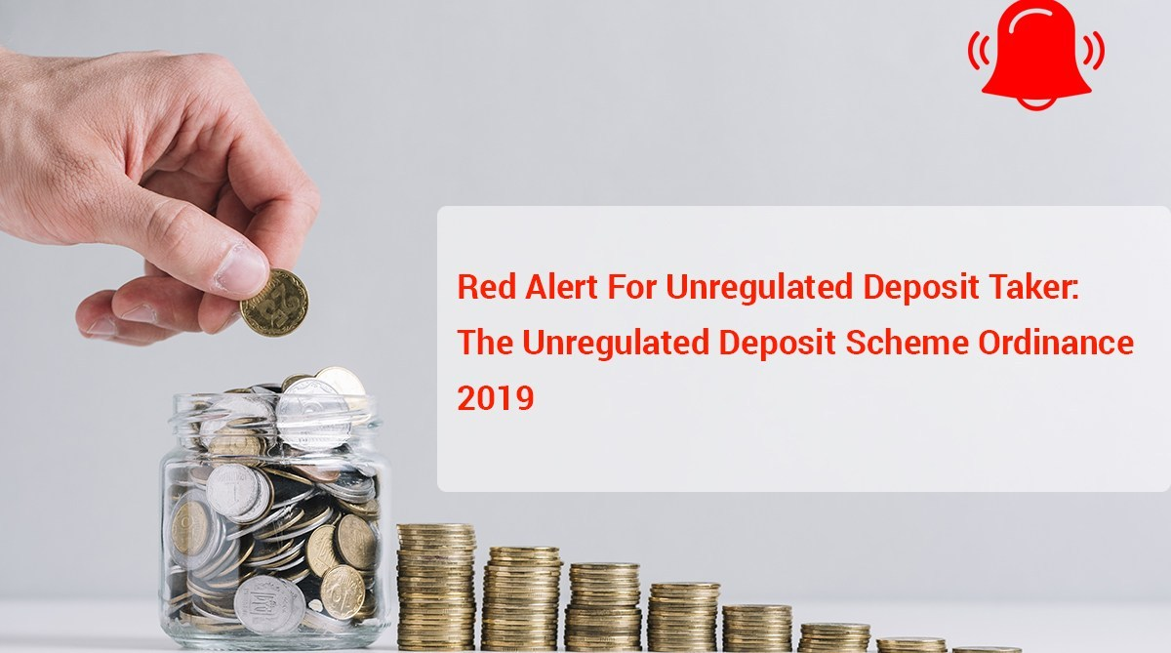
Who is a “Deposit Taker”?
Any individual or group of individuals
A proprietorship concern
A partnership firm
LLP
A Company
An AOP
A Trust
A Co-operative Society
Any other arrangement of whatsoever nature,
receiving or soliciting deposits , but does not include
A Corporation incorporated under an Act of Parliament or State Legislature
A Banking Company

Slide 16
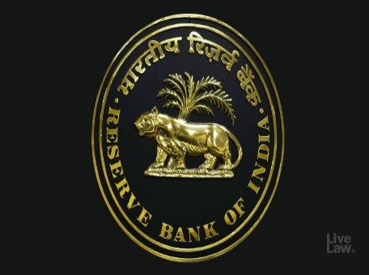
REGULATED DEPOSIT SCHEME
“Regulated Deposit Scheme” means the Schemes specified under column (3) of the First Schedule;
A deposit scheme has been defined as regulated scheme if it is registered with any of following nine regulators:
SEBI
RBI
IRDA
State Governments – Co-operative society, Chits, Money lending authorities.
National Housing Bank
Pension fund regulatory and development authority (PFRDA)
Employees Provident Fund Organisation (EPFO)
Central Registrar Multi-state Co-operative Societies
Ministry of Corporate Affairs (MCA)

Slide 17
What is UDS ???
Defined in the Ordinance u/s 2(17)
A scheme or an arrangement under which deposits are accepted or solicited by any deposit taker by way of business and which is not regulated deposit schemes as specified in 1st Schedule of the Ordinance
A Prize Chit or a money circulation scheme banned under the provisions of the prize Chits and Money Circulation Scheme (Banning ) Act 1978 shall be deemed to be an UDS.

Slide 18
BANNING OF UDS ( CHAPTER II)
From the date of commencement of this ordinance
The UDS shall be banned.
No deposit taker shall directly or indirectly promote, operate, issue any advertisement soliciting participation or enrolment in or accept deposits in pursuance of an UDS.

Slide 19
BANNING OF UDS ( CHAPTER II)
No deposit taker, while accepting deposits pursuant to a Regulated Deposit Scheme,
shall commit any fraudulent default in the repayment or return of deposit on maturity
in rendering any specified service promised against such deposit.

Slide 20
BANNING OF UDS ( CHAPTER II)
No person by whatever name called shall knowingly make any statement, promise or forecast which is:
False, Deceptive or misleading in material facts
Deliberately concealing any material facts inducing another person:
to invest in, or
become a member or
participant of any Unregulated Deposit Scheme

Slide 21
AUTHORITIES (Chap III)
COMPETENT AUTHORITY
The Ordinance provides for the appointment of one or more government officers, not below the rank of Secretary to the state or central government, as the Competent Authority.
The government may appoint officers as it thinks fit to assist the competent authority.

Slide 22
AUTHORITIES (Chap III)
The Competent Authority or such other officers appointed may:
(i) provisionally attach the property of the deposit taker, as well as all deposits received,
If Deposit taker solicits deposits in contravention of Sec 3
Reasons to be recorded in writing
Provisional attachment order to be in writing
The Competent Authority will have powers similar to those vested in a civil court.

Slide 23
AUTHORITIES (Chap III)
(ii) Competent Authority shall for the purpose of sub-sec(3) have same powers as vested in civil court under CPC for conducting investigation/ enquiry in respect of the following:
Discovery/inspection
Enforcing the attendance of any person
Compelling the production of records
Receiving evidences on affidavit
Issuing Commission for examination of witnesses & documents.

Slide 24
AUTHORITIES (Chap III)
DESIGNATED COURTS
Concurrence of the CJ of concerned HC necessary for constituting designated courts.
Headed by a judge not below the rank of a District and Sessions judge or Additional District and Sessions judge.
Only designated court will have jurisdiction in any matter relating to the Ordinance.
Competent Authority will approach the Designated Court [within 30 days (extendable to 60 days)] to:
(i) make the provisional attachment absolute, and
(ii) ask for permission to sell the assets.

Slide 25
AUTHORITIES (Chap III)
Power to :
make the provisional attachment absolute
vary or cancel the provisional attachment
finalise the list of depositors and their respective dues
direct the Competent Authority to sell the property and equitably distribute the money realised among the depositors
Complete the process within 180 days

Slide 26
Information On Deposit Takers
Central Database :
The Ordinance provides for the creation of a body that maintains an online database of legitimate deposit takers and schemes operating in India.

Slide 27
Information On Deposit Takers
Intimation of business by deposit taker:
Every deposit taker which commences or carries on it’s business after the commencement of this Ordinance should intimate to the authority referred to in Sec 9(1) about it’s business in such form and manner and within such time as may be prescribed.
The competent authority may direct any deposit taker to furnish such statement or information , if he has reason to belive that deposits are solicited / accepted pursuant to UDS.

Slide 28
While Section 3 operates as a ban for URDS, Section 10 requires intimation by every deposit takers and verification by a competent authority as to whether the deposits are pursuant to an URDS.
Deposits as defined not falling within the exclusion if taken by any deposit taker would require an intimation to the authority in the prescribed format.
On one hand, Section 3 operates as a ban and the regulated schemes are very limited in the list set out in the First Schedule.
On the other hand, Section 10 requires, intimation. There appears to be a conflict between Section 3 and Section 10 given the fact that the list in Schedule-1 is very limited.

Slide 29
Information to be Shared
Competent Authority shall share all the information received u/s 29 with the CBI & authorities designated by Central Govt.
Appropriate Govt., Regulators, IT Authorities& other investigating Agencies investigating offences under this Ordinance shall share all the information with Police /CBI.

Slide 30
OFFENCES
Running (advertising, promoting, operating or accepting money for) unregulated deposit schemes,
Fraudulently defaulting on regulated deposit schemes,
Wrongfully inducing depositors to invest in unregulated deposit schemes by willingly falsifying facts

Slide 31
Offence and punishment under the Ordinance
Sl.No | OFFENCE | IMPRISONMENT | FINE (in Rs.)
1. | Solicit deposits under Unregulated Deposit Schemes | 1 year – 5 years | 2 lakhs to 10 lakhs
2. | Accept deposits under Unregulated Deposit Schemes | 2 years – 7 years | 3 lakhs to 10 lakhs
3. | Fraud in repayment of deposits accepted under Unregulated Deposit Schemes | 3 years – 10 years | 5 lakhs to 200% of aggregate funds collected
4. | Fraud in repayment of regulated deposits | Up to 7 years | 5 lakhs to higher of 25 crore or 3 times the amount of profit made out of such fraud

Slide 32
Sl.No | OFFENCE | IMPRISONMENT | FINE (In Rs.)
5. | Failure to render service promised against regulated deposits | Up to 7 years | 5 lakhs to higher of 25 crores or 3 times the amount of profit made out of such fraud
6. | Wrongful inducements in relation to Unregulated Deposit Schemes | 1 year – 5 years | Up to 10 lakhs
7. | Repeated offenders | 5 years – 10 years | 10 lakhs – 50 crores
8. | Failure to file intimation by deposit taker about its business, or to furnish statements, information or particulars to the competent authority | – | Up to 5 lakhs

Slide 33
INVESTIGATION, SEARCH & SEIZURE
Every offence punishable under this Ordinance except u/s 22&26 shall be cognizable and non bail-able.
Police officer will inform to Competent authority about offence committed.

Slide 34
INVESTIGATION, SEARCH & SEIZURE
If Competent Authority has a reason to believe that offence relates to a deposit scheme / deposit scheme in which :
the depositors, deposit takers/ properties involved are located in more than one State / Union territory in India /Outside India; &
The total value of amount involved is of such magnitude as to significantly affect the public interest,
the Competent authority shall refer the matter to Central Govt. for investigation by the CBI

Slide 35
Position Of Deposits With Partnerships
Capital Contribution by Partners
Excluded
Loan From The Relatives Of Any Of Its Partners
Excluded
Loans From Third Parties And Other Firms
In course of business or in connection with business = Excluded
Whether this clause can come to the rescue or not is a matter of interpretation.

Slide 36
Position of Deposit with Individuals/ Sole Proprietorship
Loan From Relatives
Excluded
Loans Taken From An Individual From Friends And Associates
Excluded

Slide 37
Position Of Deposit With Companies
The schedule 1 of the ordinance considers deposits accepted or permitted under the provisions of Chapter V of CA 2013 as regulated deposits.
Any deposit accepted by companies which is not allowed in CA 2013 may come under Unregulated Deposit and therefore such companies will be at risk of facing action from Companies Act as well as BUDS.

Slide 38
Position Of Deposit With Companies
A deposit accepted or permitted under Chapter V of the Companies Act is listed in Schedule-1 and is therefore considered as a regulated deposit scheme.
However, Section 10 requires intimation even in respect of a company accepting deposit under Chapter-V of the Companies Act. We will have to wait for rules in this regards.

Slide 39
CONCLUSION
It is noteworthy to understand the difference between “Deposits for Business” and “Business of Accepting Deposits” and according to this Ordinance, latter one i.e. “Business of Accepting Deposits” which is Unregulated, is banned.
There is no ban on Individuals / Firm / Companies receiving loans for their business purposes.
For individuals, firms or corporate taking loans from relatives or friends for business or for other personal reasons, will not be affected by this Ordinance.

Slide 40
